Slide 1
Privacy Issues With Sensor Data Collection
Michael Froomkin University of Miami School of Law froomkin@law.miami.edu

Slide 2
Privacy, Quickly
Has multiple elements including control of access to body, to thoughts, protection of private sphere, and especially intimate relations
Today will concentrate on one aspect: ability to control data about oneself
Primarily an instrumental value
Enhances human freedom, flourishing, experimentation, innovation, self-realization; protects against discrimination, and also distant, often invisible, exercises of (often algorithmic) power

Slide 3
Data == Power
People with data about you can exercise power over you
Market power
Government power
Special case of both above: Sorting power
Can be invisible
Can be lifelong
Can be very empowering – or very damaging
Credit scores
Citizen safety scores
Issues of accurate, inaccurate, and predictive (i.e. speculative) scoring

Slide 4
Data Types (By Method of Collection)
Organic data flows
Data streams that are currently collected either in the course of business or to comply with regulatory requirements.
Can be very detailed (e.g. NYC taxi rules require logging every pickup and drop-off)
And thus can be very revealing (strip club attendees; low-tipping celebrities)
Distributed sensors
CCTT, License plate readers, biometrics
Special-purpose sensors
NY skyscraper cams & heat sensors
Self-surveillance
Instagram metadata, many cell phone apps
[Information derived from above:] Correlations (i.e.. Big Data products)

Slide 5
Big Data, Quickly
US government definition: the growing technological ability to capture, aggregate, and process data
EU: “the massive and rapid processing of data (through modern data analytics) in the search for information (including unforeseen information) The practice of data mining poses a significant challenge due to the degree of opacity characterising many contemporary data processing activities. ...
Data mining practices may result in “behavioural targeting” and further encourage a “datafication” of society that poses significant challenges for privacy and digital rights in general. Due to such risks as statistical discrimination...
Bottom line: Big Data is both a technology and a process with many (reinforcing) parts, each of which can be enabled or, in theory, regulated. It is also, arguably, an ideology.

Slide 6
Big Data as a Process
Data collection
Sensors: Smart city, Cell Phones
Self-surveillance
Transactional data: Communications, Shopping, Medical
Storage
Processing
Correlation / Data Mining
Issues of identification/ de-identification/ re-identification
Re-Use
Nature of Big Data projects is to seek unexpected connections

Slide 7
The Trend is to Ever-More Data Collection, Hence More (and Bigger) Data
More apps creating occasions to create and collect data
More monitoring
VACCINE (ccTV nets)
So called ‘self-surveillance’ e.g. Fitbits, Nests
Ubiquitous hardware/sensors
Bigger aggregations of data
Smart cities
Fusion centers, DHS, NSA
Cost/benefit motivates private sector: costs are dropping, perceived benefits growing

Slide 8
The Lure of Unexpected Insights
“What if I told you that ...one of the biggest decisions a company makes revolves around the size of its lunch tables?”

Slide 9
And the Data Streams Keep Coming
Smart Meters
Smart Cars (or self-driving & gridded)
Mobile & personal care robots
‘Always on’ voice recognition devices
Amazon Echo, Google Home, Apple TBA
IoT devices more generally

Slide 10
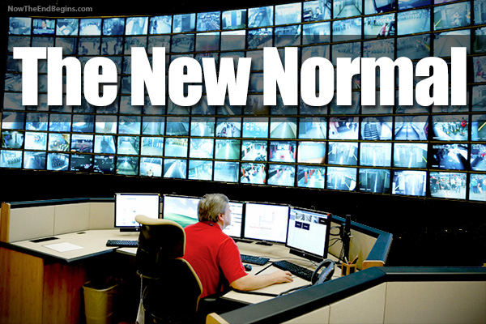

Slide 11
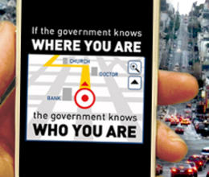
Data Can Hurt People; So Can Data Collection
Discrimination
Redlining
Unintentional, invidious algorithms
State Power
Investigation of Occupy Wall St. protestors
Being watched is intimidating, silencing

Slide 12
Are You Trusted? Or ‘Dangerous’?
"Beware," a program made by West Safety Services is capable of quickly sorting through billions of publicly available commercial records to alert first responders to potentially dangerous situations, according to the product website. Beware calculates “threat scores” by assigning people and addresses green, yellow, or red scores with red being highest threat and green being the safest.

Slide 13
Mixed Blessings of Big Data
Benefits – Numerous, Usually Concentrated
Costs – Widespread, Diffuse, Harder to Quantify
Medical, Epidemiology
Security
Finance
Marketing
Urban planning
“Quantified Self”
Privacy reduced or eliminated
Increases risk of reprisal for acts
Less experimentation
Dossiers are bigger
Increased opacity in decision-making
Polity
Self-censorship
Unpredictable consequences of speech, civic choices
Less whistleblowing

Slide 14
More & ‘Better’ Algorithms
As they are fed more data
Can infer results about you based on people who share observed traits about you, another way in which there is no occasion for consent on your part, if other have consented to deeper dive into their data
Thus, big data is a power shift - away from data subject towards those who control and can access the data.

Slide 15
Common Privacy Protection Techniques Fail
Consent to data collection loses what little meaning it has
“Consent” is meaningless for remote sensing
In US ‘consent’ not required for most transactional collection unless “sensitive”
“Informed consent” is impossible if one cannot predict what effect the data use might have
Processing limits are inadequate
US law bans ‘discrimination’ against certain classes e.g. race, religion
But no law against discriminating against people who pay for pizza with credit
Battle over no-fly lists is going very slowly
Data anonymization easily undermined
Re-identification is easy and likely profitable

Slide 16
Metaproblem: Attitudes
As Julie Cohen says, Big Data repackages surveillance as innovation. Plus, “Big Data ... equates information with truth and more information with more truth, and that denies the possibility that information processing designed simply to identify a ‘pattern’ might be systematically infused with a particular ideology.”
“[P]rivacy is increasingly cast as the spoiler in this tale, the obstacle to the triumphant march of predictive rationalism. ... [I]f information processing is rational, then anything that disrupts information processing, including privacy protection, is presumptively irrational.”
If Cohen is correct that Big Data is the result of an ideology then we should be wary of the argument that the value of insights drawn from huge datasets justify the creation of centralized (OR federated!) repositories and their use.

Slide 17
This is Not Just a Data Collection But Also a Systems Issue
Privatizing, distributing, or ‘federalizing’ the data makes little difference.
US Law (1st Am) makes ‘unseeing’ and RTBF unlikely
But there is a very limited ability to prohibit invidious uses in regulated industry
Rules for sharing and re-use are as critical as rules for collection
Also need algorithmic transparency (but must be comprehensible)
Data moves between public and private sectors unless legislation forbids sale or disclosure.
This is rare, but does happen:
Video Privacy Protection Act (no sharing Video Rentals)
Driver Privacy Protection Act (no selling drivers license data)

Slide 18
What Can Be Done
Limit sensors/data collection
Publicize fact of collection; publicize use/re-use of data
Impose costs on collection to cure market failure
Regulate storage or flows (sharing)
Age out data
RTBF
Limit use/re-use once holding data
Forbid sales of public data to private parties without stringent conditions on re-use, re-sale
Focus on discrimination: ban ‘bad’ algorithms (but enforcement hard, and unconscious biases in algorithmic design or in data set construction)
Create a new due process in data processing
Right to contest distant, invisible algorithmic decision making
Give individualized (expensive!) notice of when, how and why your data is being processed
Invent new ways to opt-in and opt-out
But opt-out options need to be realistic not formalistic

Slide 19
Takeaways
Key point1: No one can predict the implications and uses of ANY data stream, given the power of correlations
Effects of data streams will change
Transparency is essential – but alone is not nearly enough, because…
Key point 2: INFORMED CONSENT IS NOT POSSIBLE (Long range + #1 above)
If system design capable of info collection OR correlation then must design strong technical AND legal barriers against misuse:
Pre-collection/use review (IRB on steroids)
Regular audit of compliance and also of possible new uses/ harms of data
Mechanism for external review/enforcement (overcome standing, valuation issues that block legal process)

Slide 20
